Slide 1
An Exploration of Lighting Techniques in 3D Graphics Using OpenGl
By Luca Napora

Slide 2
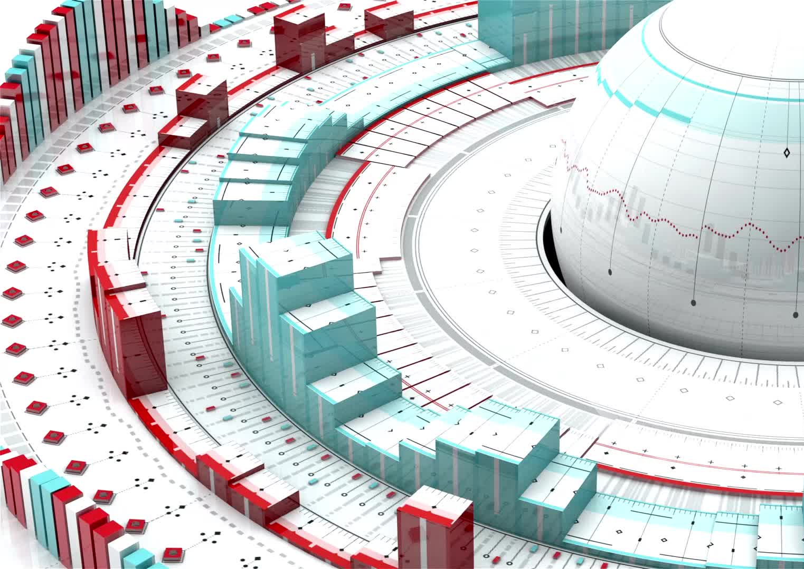
What Are Computer Graphics?
the representation of visual content on a computer
Two-dimensional and Three-dimensional graphics
Modern-Day Uses
Special effects in movies and television (CGI)
Architectural models
Medical imaging

Slide 3
Project Goals
Investigate the various lighting models and lighting implementations found in 3D graphics
Implement two commonly used lighting models to analyze their effectiveness
Phong Shading Model
Gouraud Shading Model
Tools:
OpenGl (API)
C++
GLEW (Graphics Library Framework): create an OpenGl window
GLAD (GL Adapter): load OpenGl functions

Slide 4
Major Components of Light
Ambient Light
light that already exists in a scene before any artificial lighting is added
“Natural light”
Comes from all directions

Slide 5
Major Components of Light Cont.
Diffuse lighting
when light reflects from a surface in all directions
How the light interacts with a surface

Slide 6
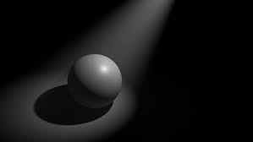
Major Components of Light Cont.
Specular Lighting
A light that retains its reflective qualities
The bright spot that appears on shiny objects

Slide 7
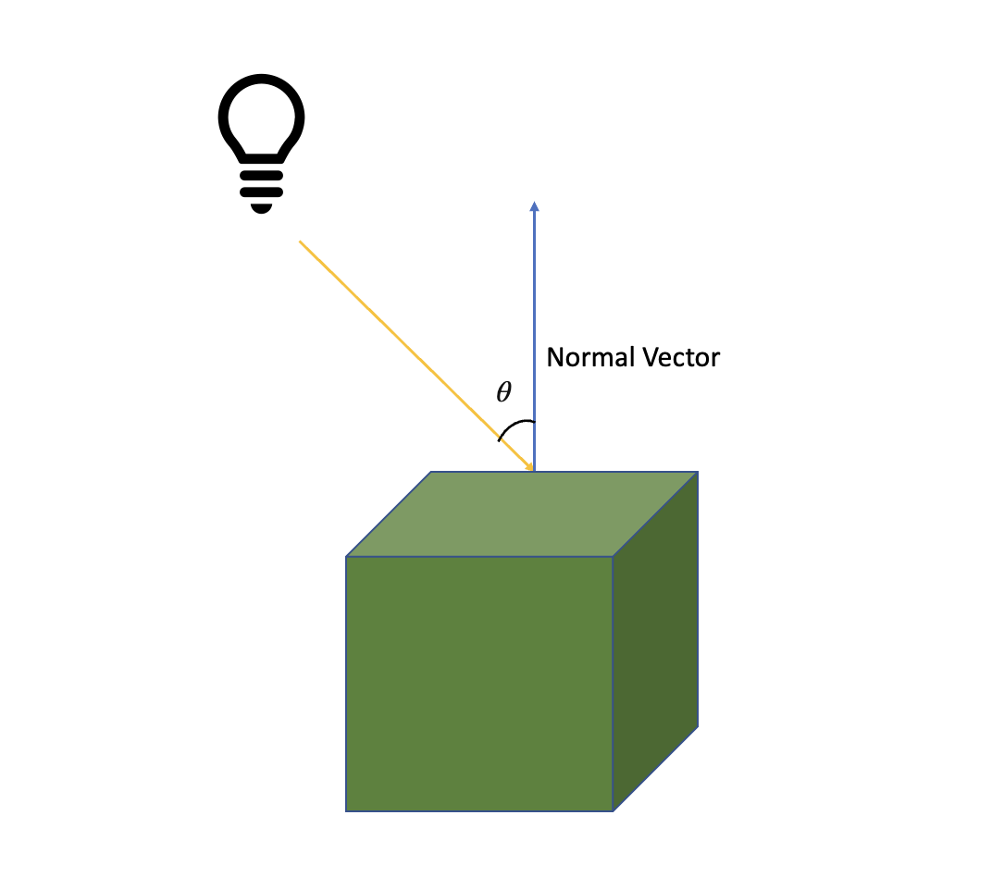
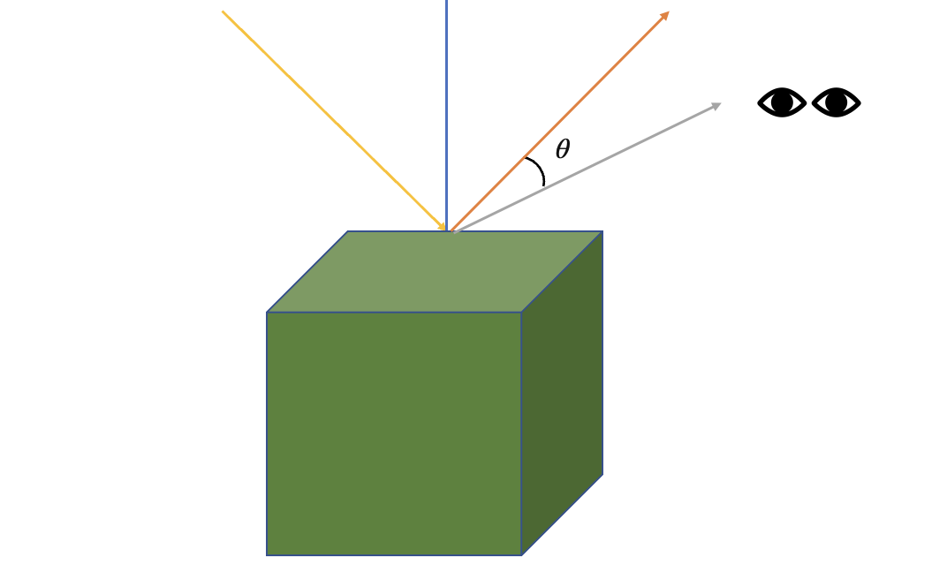
Phong Shader Model
Lighting models: algorithms to simulate light
Phong Shader Model: calculates ambient, diffuse, and specular elements per pixel

Slide 8
Phong Shader Model Implementation

Slide 9
Gouraud Model
calculates the color intensity at each point on the polygon using a linear interpolation of the colors at the vertices
More computationally efficient

Slide 10
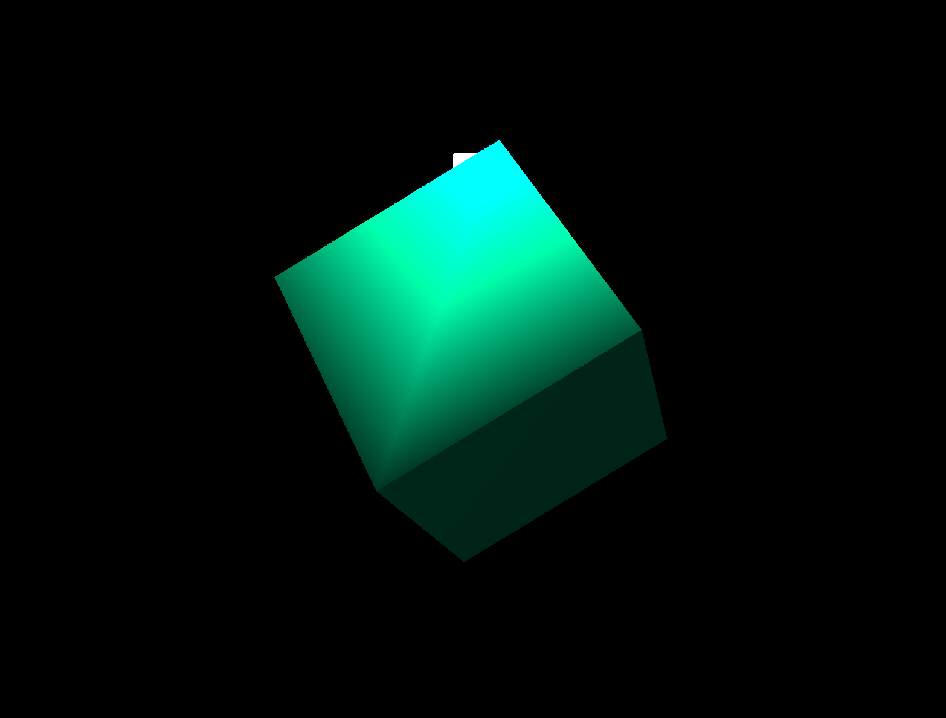
Findings
The Gouraud Model results in linear fragmentation
interpolation of colors between the vertices of the triangles that form each side of the cube is done in a linear manner
Results in these “stripes”

Slide 11
Conclusion
The Phong Model less efficient but prevents the possibility of linear fragmentation by calculating per/pixels
The Gouraud Model is more efficient but has the possibility for linear fragmentation, especially when using specular light
Future work:
The introduction of adding lighting maps
light behaves differently depending on the fragment’s texture
adding light casters

